Slide 1
Classes and Objects

Slide 2

To Do:

Slide 3
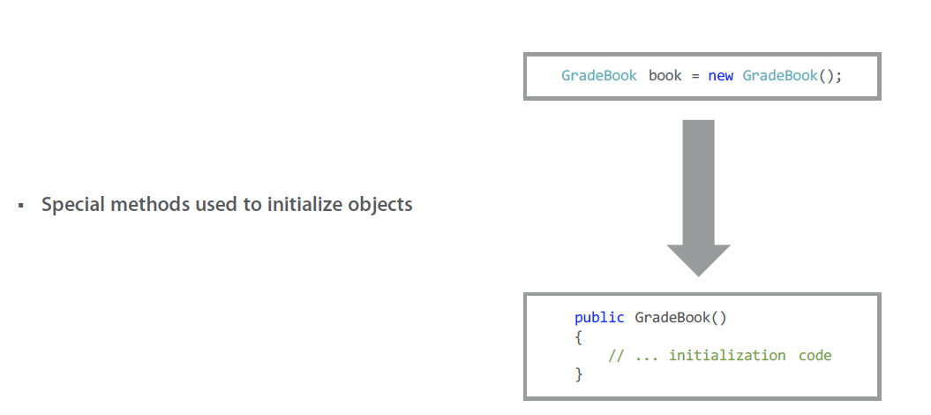
Constructors

Slide 4
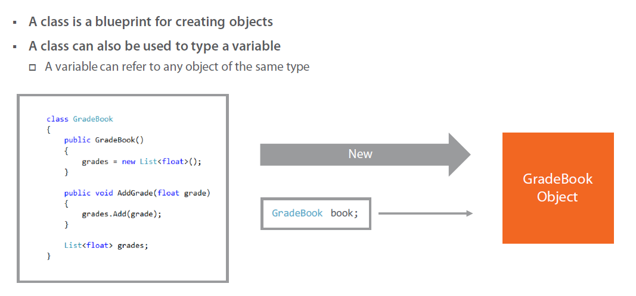
Class versus Variables

Slide 5
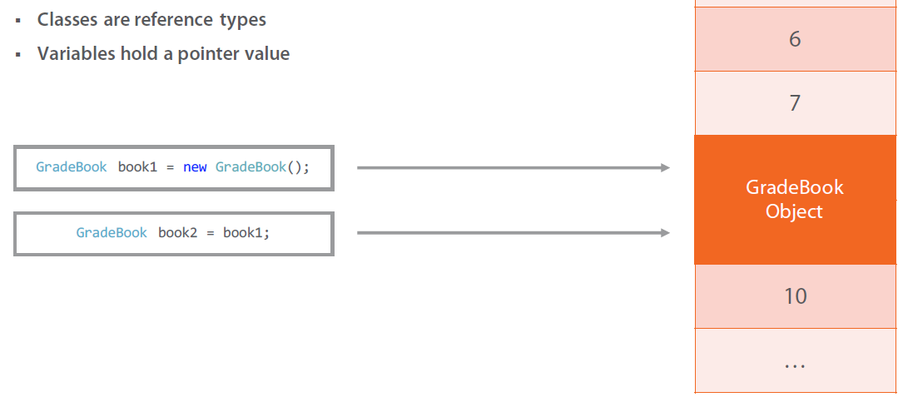
Reference Types

Slide 6
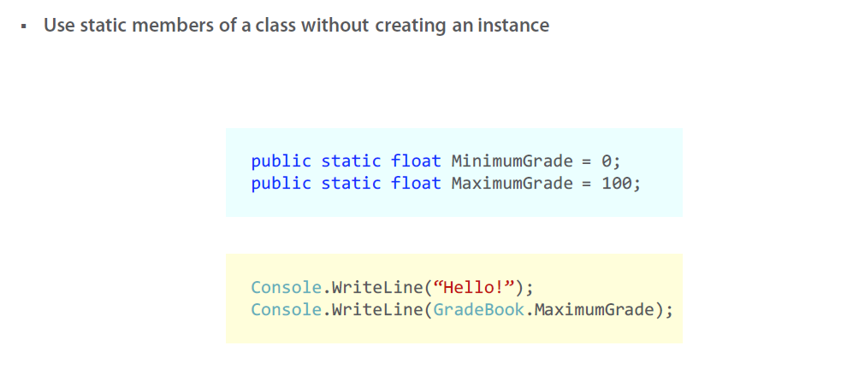
Statics

Slide 7

Classes

Slide 8

Object Oriented Programming

Slide 9
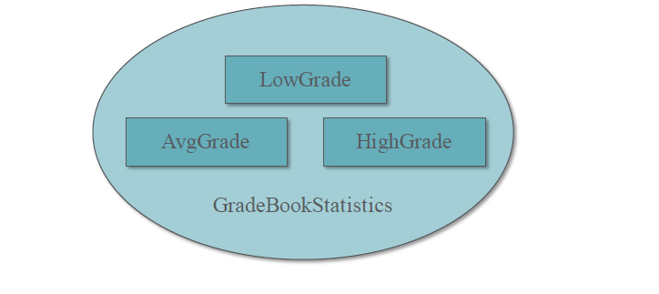
Encapsulation

Slide 10
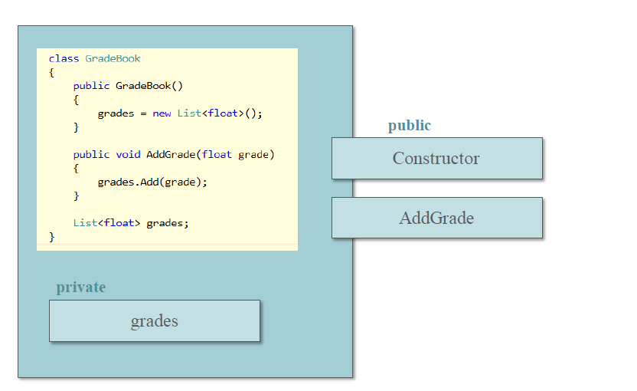
Access Modifiers

Slide 11
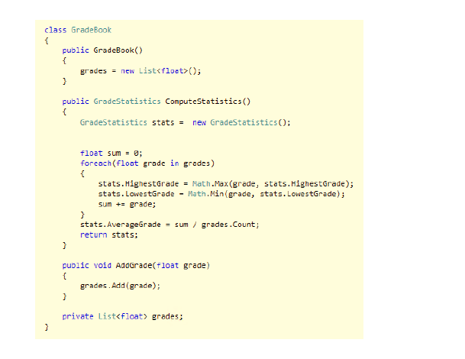
Summary

